Slide 1
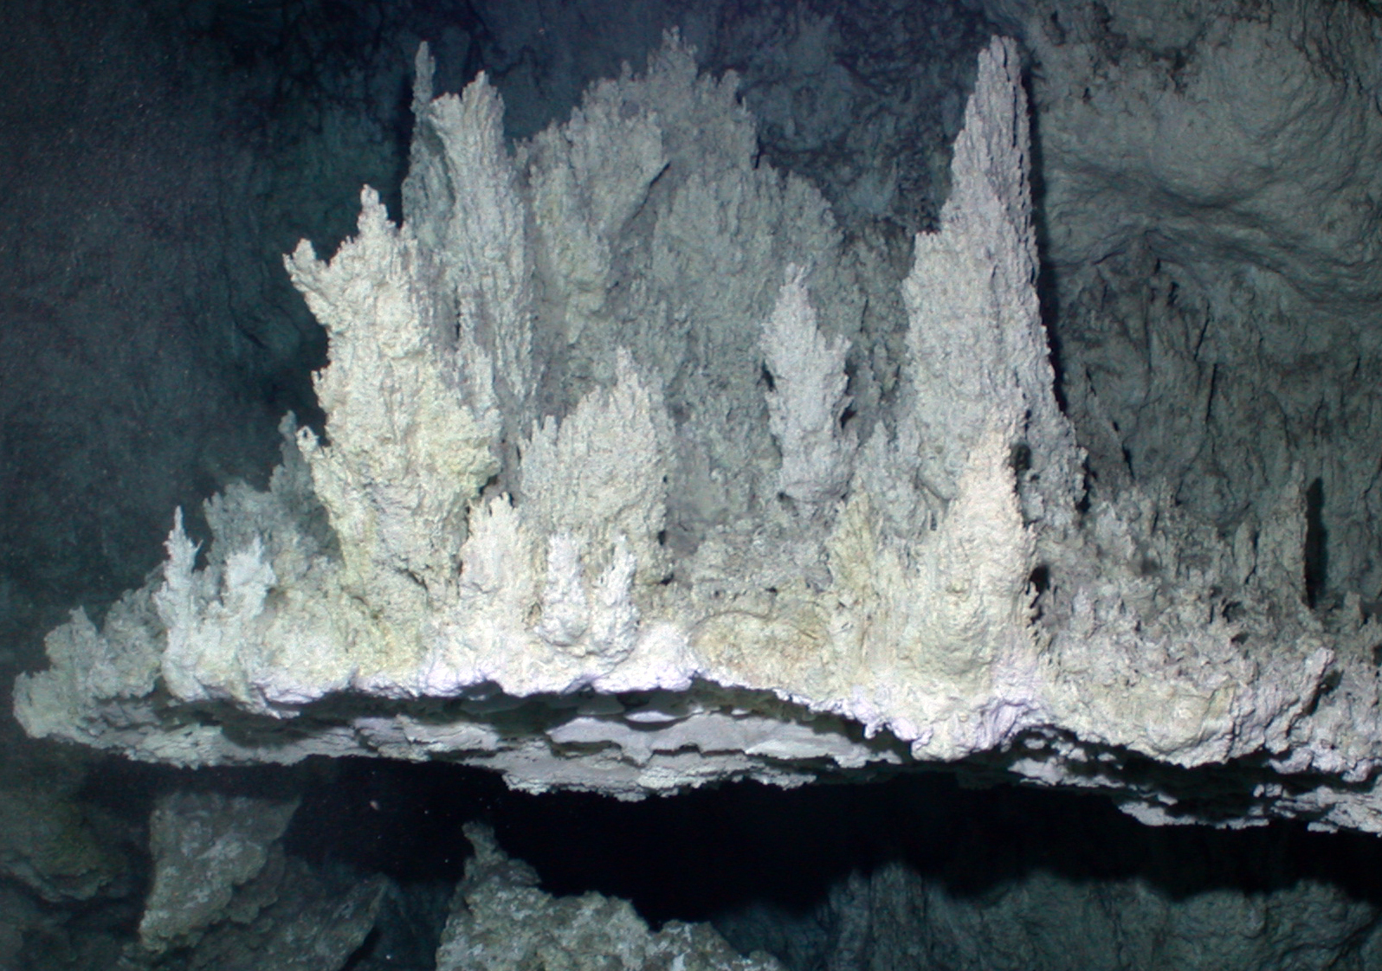
+
+
+
+
+
+
+
+
+
“life is not so much a reaction as a side reaction of the cell's core bioenergetic process”
+
+
(Land and Martin 2012)
+
+
Image source: http://www.lostcity.washington.edu/files/kelley.2005bsm.pdf

Slide 2
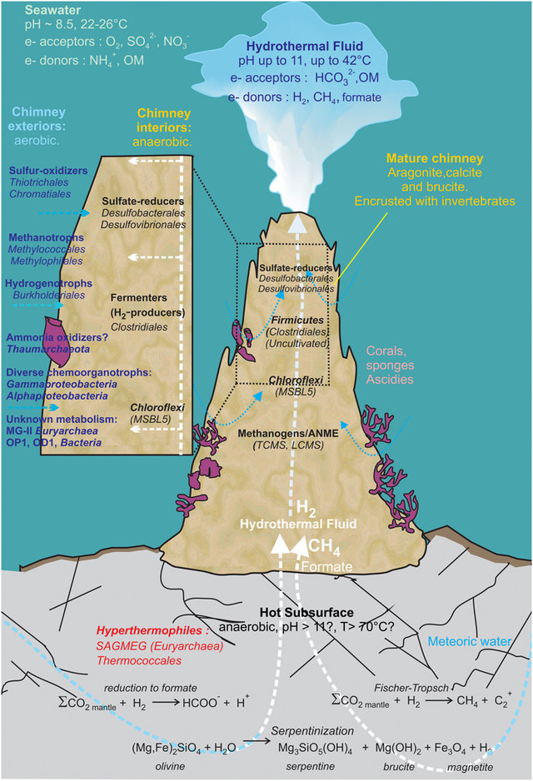
Driven by serpentinization, not magma as in “black smoker” hydrothermal vents. Not volcanic.
Stable and long-lasting – up to 300,000 years by some estimates.
Hydrothermal fluid is warm (up to 42C vs ocean 24C), and alkaline (pH11 vs ocean pH 8.5). Also some hydrogen, methane, formate.
Towers made from deposits of calcite (CaCO3), aragonite (CaCO3), and brucite (Mg(OH)2).
Image source: https://www.frontiersin.org/articles/10.3389/fmicb.2015.00857/full

Slide 3
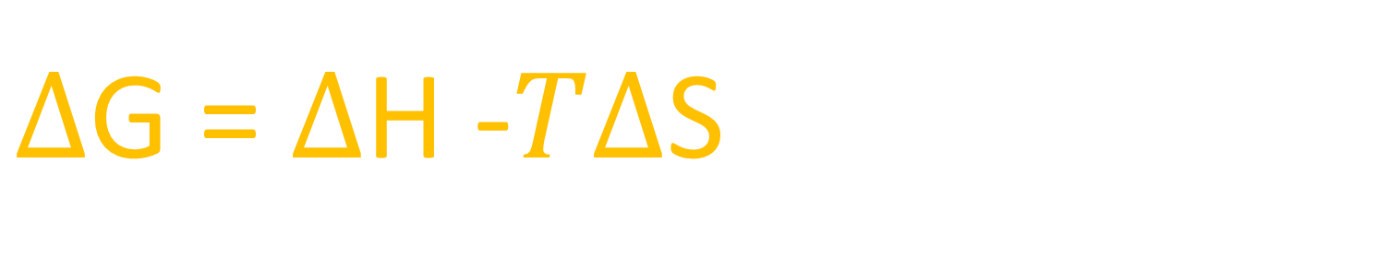
What makes alkaline vents so important?
There is a boundary between the warm, alkaline vent water and the cold, acidic ocean water provides a sustained, consistent far-from-equilibrium condition—something very hard to find!
Cells are low-entropy, which can only be maintained if counterbalanced by an even larger decrease in enthalpy. The earliest life forms decreased the entropy of the matter around them by harnessing an energy flow.
$∆$G = $∆$H -$T∆$S
Very different from something like a lightning strike in a primordial soup, which is high entropy and does not sustain any kind of disequilibrium.

Slide 4
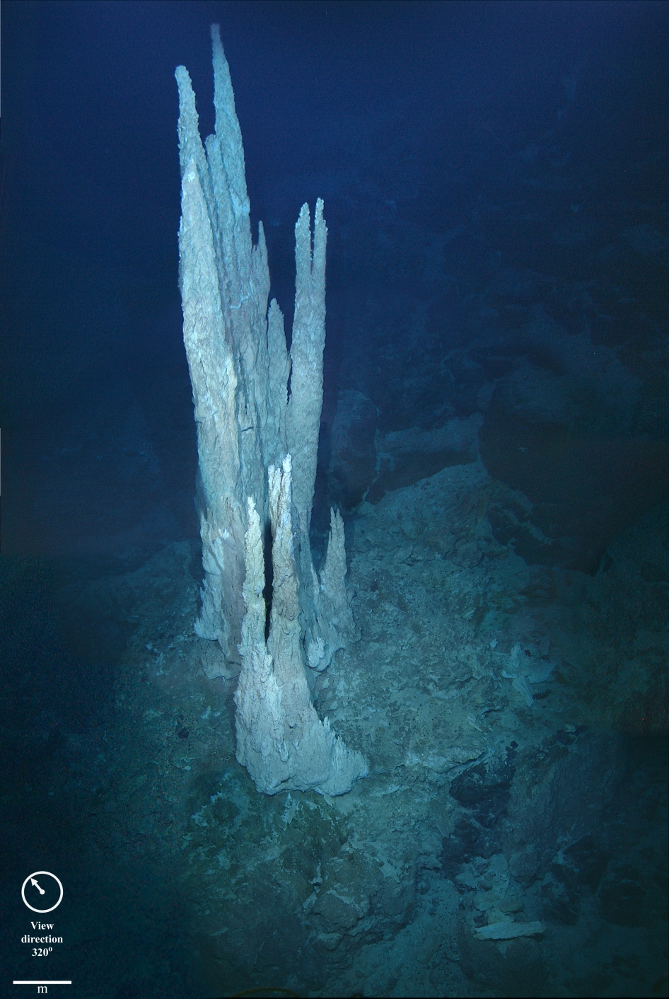
We don’t have to go back in time—these conditions are still here
Image source: https://www.capeandislands.org/post/new-book-highlights-stars-sea-floor#stream/0

Slide 5
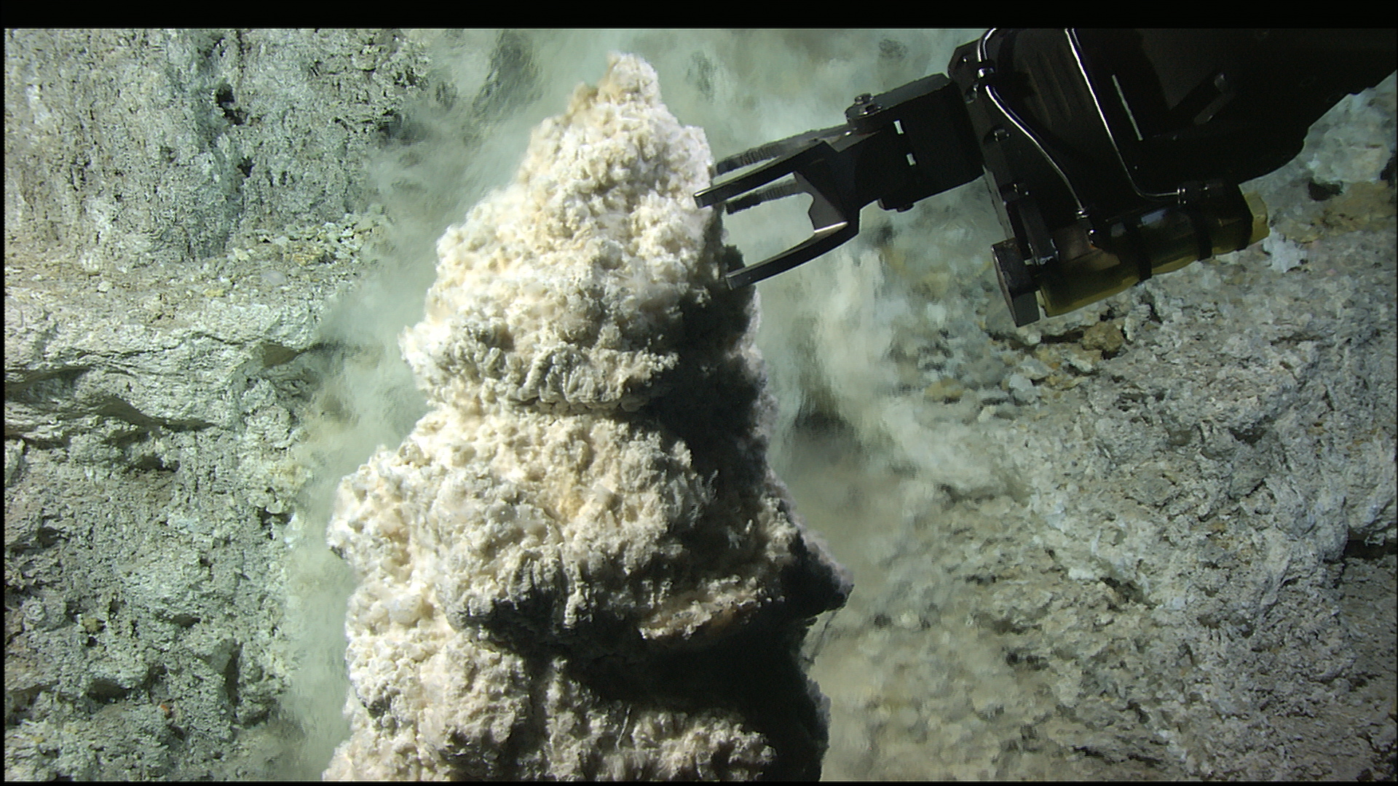
Not solid – Porous and crumbly
Image source: https://deepcarbon.net/feature/methanogens-can%25E2%2580%2599t-make-it-their-own-lost-city

Slide 6
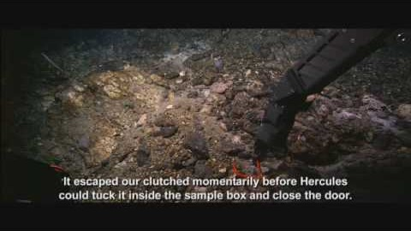
https://www.youtube.com/watch?v=F7wnrE3_i8A&t=364s

Slide 7
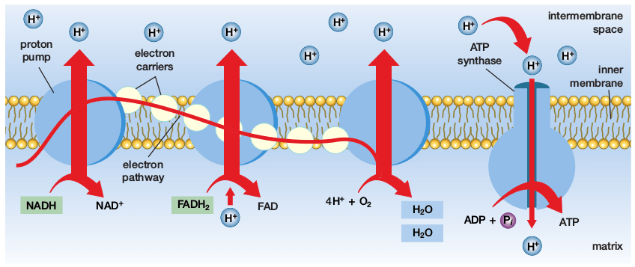
Chemiosmosis is universal – life is in disequilibrium
Image Source: https://plomberie-serrurerie.com/charts_rm.php
As universal as the genetic code!
ATP synthase is universal, but ion pumping machinery is not. Suggests that the proton gradient came first.

Slide 8
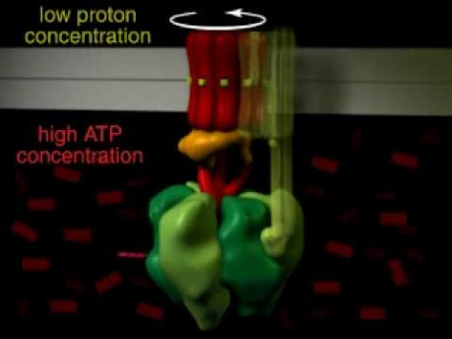
https://www.youtube.com/watch?v=PjdPTY1wHdQ

Slide 9
Core of the theory – energy flow
All points to the idea that life originated when a geological energy flow turned into a biological energy flow.
First biological catalyst enhanced processes that arose spontaneously.
Driven by natural selection, not random chance.

Slide 10
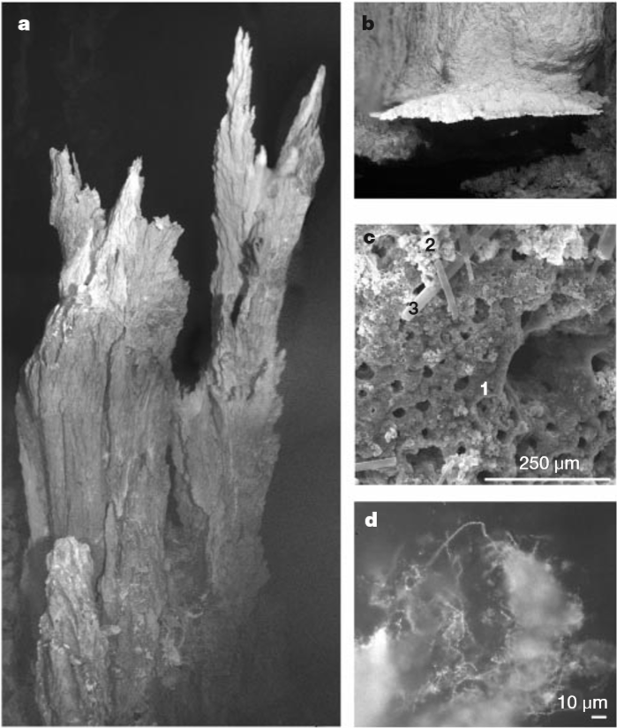
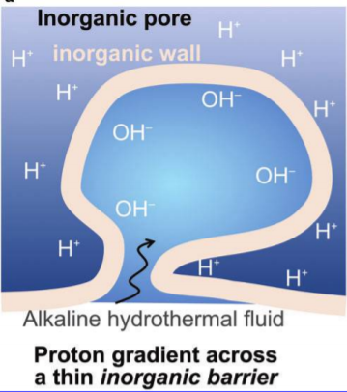
Alkaline hydrothermal vents generate natural proton gradients
(Kelly et al. 2001)
(Sojo et al. 2016)

Slide 11
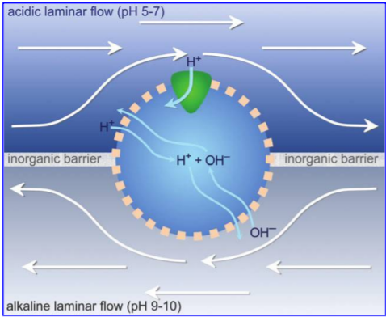
A leaky barrier allows for a continuous proton flow
Problem: At this point, anything that makes the membrane less permeable will kill this energy flow.
How did ion-impermeable membranes evolve? We’ll get to that.
(Sojo et al. 2016)

Slide 12
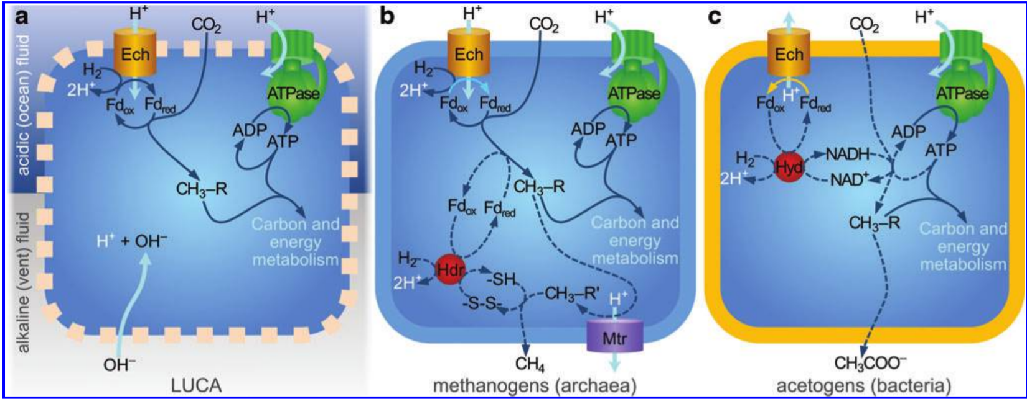
The Invention of Ion Pumping
At a hydrothermal vent, a leaky membrane allows a cell to establish a ferredoxin energy currency and a primitive carbon metabolism
Ion pumping provides an immediate metabolic advantage at a hydrothermal vent
Ion pumping, now established, allows the evolution of a non-leaky membrane, independent vesicles, more complex metabolism, invention of methanogenesis and acetogenesis
(Sojo et al. 2016)

Slide 13
So where did those proteins come from?
There is evidence that the building blocks of life, lipids, nucleic acids, amino acids, can naturally accumulate at high concentrations in these kinds of vents
The metabolism-first hypothesis says that proteins and nucleic acids arrived, but only AFTER an energy flow was established, to function as CATALYSTS to enhance a pre-established geological energy flow.
For example, ferredoxin proteins are an improved version of the naturally-occurring mineral surfaces that mediate electron transfer

Slide 14
Big picture – benefits of this theory
Proposes that life started in conditions somewhat similar in chemistry (temperature, pH) to modern life.
Does not require any “exotic” metabolisms that use UV radiation, cyanide, lightening, volcanoes, CO as a source for carbon fixation, etc.
Provides an explanation for the membrane differences between eubacteria and archaea
Employs natural selection (as opposed to random spontaneous generation) to explain the invention of RNA, protein, genetic material

